Slide 1
NAUSEA &Vomiting
Introduction to Medicine Course
Reza Malekzadeh M.D AGAF
Professor of Medicine
Digestive Disease Research Institute Shariati Hospital
Tehran University of Medical Sciences

Slide 2
Learning Objectives Following this lecture, students should be able to:
Provide a brief description of nausea,vomiting,regurgitation..
Describe the key events in vomiting
Describe the various triggers for vomiting
Be aware of the role of the chemoreceptor trigger zone (CTZ) and vomiting centre (VC) in vomiting
Know the major classes of antiemetic drugs, their clinical uses and be able to outline their proposed mechanisms of action
5-HT3 receptor antagonists
Muscarinic receptor antagonists
Dopamine receptor antagonists
Cannabinoids
List the major consequences of severe vomiting

Slide 3
Terminology
Nausea: from the Latin naus (ship); a very unpleasant sensation that one may vomit
Retching (dry heaves): muscular activity of the abdomen and thorax, often voluntary, leading to forced inspiration against a closed mouth and glottis without oral discharge of gastric contents
Vomiting: involuntary contractions of the abdominal, thoracic and GI (smooth) muscles leading to forceful expulsion of stomach contents from the mouth.

Slide 4
Terminology
Regurgitation: effortless return of esophageal or gastric contents into the mouth unassociated with nausea or involuntary muscle contractions
Rumination: food that is regurgitated postprandially, re-chewed and then re-swallowed

Slide 5
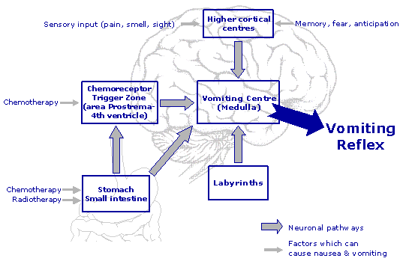
Nausea Pathway

Slide 6
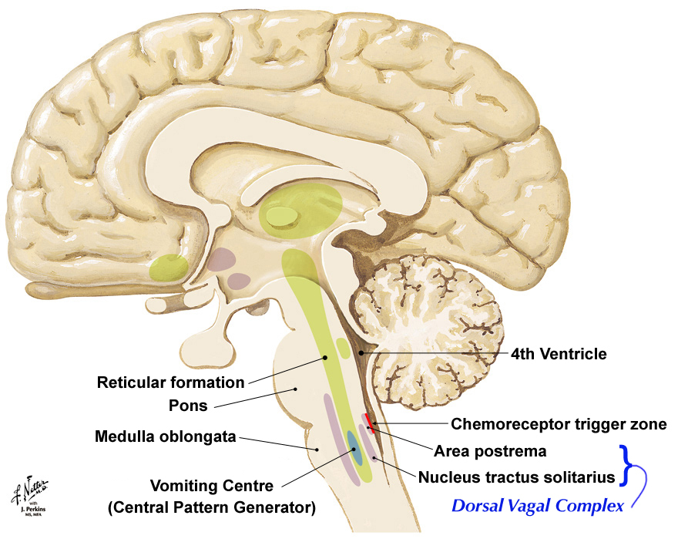

Slide 7
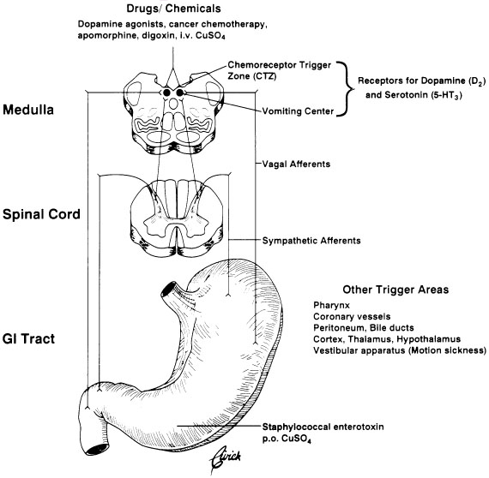
VOMITING
PATHWAYS
Ipecac syrup

Slide 8
A Central Final Pathway for Nausea
(Dopamine, Serotonin)
???
CTZ
CNS
VOMIT
CENTER
(Acetylcholine,Histamine)
VestibularApparatus
GI Tract
(Acetylcholine, Histamine)
(Acetylcholine,Histamine, Serotonin
+ mechanoreceptors)

Slide 9
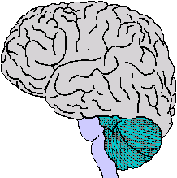
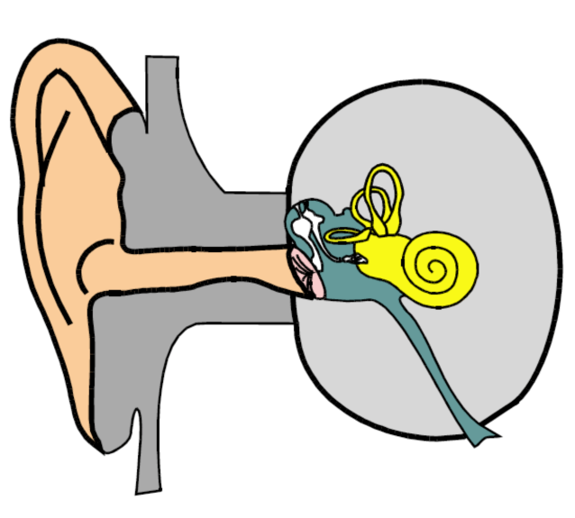
Muscarinic
Serotonin
Neurokinin-1
Cannabinoid
Histamine
Dopamine
Cortex
Sensory input
Anxiety, memory
Meningeal irritation
Increased ICP
CTZ
drugs, metabolic
dorsal vagal complex
GI
Vomiting Center (Central Pattern Generator)
Vestibular
VOMITING
CENTRE
motion
CNS lesions
opioids
aggravates most nausea
serotonin release from mucosal enterochromaffin cells
obstruction
stasis
inflammation

Slide 10
Triggers for Vomiting
Pain, repulsive sights, smells, emotional factors
Motion (inner ear), signalling to vestibular nucleus
Pharyngeal stimulation, gastric,distal Esophgeal /duodenal distension, or irritation
NTS
CTZ
Retching, vomiting
Endogenous toxins, drugs, vagal afferents
Lacks blood brain barrier (BBB)
VC
NTS = nucleus tractus solitarius

Slide 11
Major Classes of Antiemetic Drugs
5-HT₃ receptor antagonists (e.g. ondansetron)
Used to suppress chemotherapy- and radiation-induced emesis and post-operative nausea and vomiting
Block peripheral and central 5-HT₃ receptors
Cytotoxic drug
Circulating, or locally released 5-HT
Peripheral terminal in gut
Central terminal
5-HT
AP (containing CTZ) and NTS
Vagal afferent
Vomiting centre
Radiation
= 5-HT₃ receptor
AP = area postrema; NTS = nucleus tractus solitarius
Emesis

Slide 12
Epidemiology
Systemic review of prevalence of symptoms in those with serious illness:
Top 3 (consistently >50%): pain, breathlessness, and fatigue
Nausea: 16%-68% of patients
AIDS 43%
ESRD 30%
CHF 17%
Cancer 6%

Slide 13
Etiology
GI tract disorders
Toxins, infections, obstruction, inflammation, dismotility
Non-GI infections
Liver, CNS, renal, lung, other
Pregnancy
Visceral inflammation
Pancreas, GB, peritoneum
Myocardial ischemia or infarction

Slide 14
Etiology
Other CNS disorders
Migraine, neoplasm, bleed
Vestibular disorders
Metabolic/endocrine imbalances
DKA, uremia, AI, thyroid, parathyroid
Alcohol toxicity
Psychogenic
Radiation exposure
Medications

Slide 15
Etiology
Medications
Chemotherapy
Analgesics
Antibiotics
Oral contraceptives
Metformin
Anti-parkinsonians
Anti-convulsants
Anti-hypertensives
Anesthetic agents

Slide 16
Less common etiologies
Rapid weight loss/body casts (SMA syndrome)
Infectious esophagitis
Opiate withdrawal
Herbal preparations

Slide 17
Causes of Nausea and Vomiting
Vestibular
Obstruction (Opioids)
Mind (Dysmotility)
Infection (Irritation)
Toxins (Taste and other senses)

Slide 18
Vestibular Apparatus
Complaint of nausea with head movement
Mediated by acetylcholine and histamine receptors
Doc(s):
Dimenhydrinate
Promethazine (supp)
Scopolamine (patch, injection)
Cyclizine (oral, injection)
Most anticholinergic,
antihistiminic drugs will help!

Slide 19
Assessment - History
Time of onset Acute or chronic
Quality? nausea, vomiting, retching, projectile
Duration? persistent versus intermittent.
Temporal issues? worse in morning?
Relationship to meals?
Contents of vomitus?
Ameliorants/triggers?
Treatments
Associated symptoms
Pain, fever, myalgias, constipation, diarrhea, vertigo, dizziness, HA, jaundice, weight loss, focal neurological symptoms

Slide 20
Nausea and Vomiting: Key Historical Questions
How long?
Relationship to meals?
Contents of vomitus?
Associated symptoms
pain in chest or abdomen, fever, myalgias, diarrhea, vertigo, dizziness, headache, focal neurological symptoms, jaundice, weight loss
Diabetes?
When was last menstrual period?

Slide 21
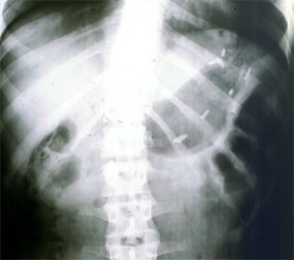
Radiopaque markers still in the stomach 6 hours after meal in a diabetic with nausea

Slide 22
Physical Examination
General Physical Exam.
Weight loss, Acute or chronic pain
Neurological Exam
Vestibular test
Ophthalmoscopy

Slide 23
Paraclinical Studies
Electrolytes, glucose, BUN/creatinine
Calcium, albumin, total serum proteins
CBC
LFTs
Pregnancy test
Urinalysis
Serum lipase w/ or w/out amylase

Slide 24
Radiological studies
Plain abdominal films
Abdominal sono or CT if pain is key feature
Brain CT or MRI if severe HA, papilledema, marked HTN, AMS, or focal neuro findings
EGD or upper GI
Gastric emptying studies

Slide 25
Most common cause of N&V in daily practice
Acute gastroenteritis usually accompany with :
Abdominal pain
Diarrhea
GERD: Chronic N&V usually accompany with
Sore mouth
Dyspepsia pyrosis

Slide 26
Psychogenic Vomiting
Usually young and female
Denial or minimization of nausea
Rarely occurs in public or in front of others
Co-existing eating disorder, laxative abuse, diuretic abuse
Psychological disturbances common
Complications may be present

Slide 27
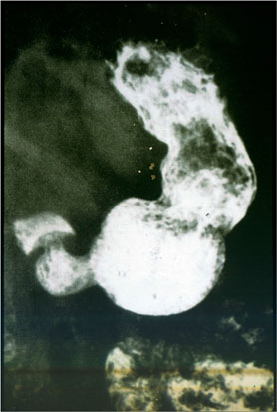
Chronic vomiting due to gastroparesis associated with a gastric bezoar

Slide 28
Treatment
Identify and treat underlying cause
Treat complications
Replace losses
Provide relief of symptoms
Empiric versus mechanistic
Use preventative measures when vomiting is likely to occur
S/P chemotherapy, parenteral opiates

Slide 29
Identify underlying causes: six sentinel questions
Intermittent nausea with early satiety, postprandial fullness or bloating. Nausea is relieved with vomiting small amounts of undigested food indicating impaired gastric emptying.
Intermittent nausea associated with cramping and altered bowel habit. Nausea relieved with large emesis sometimes bilious/feculent indicating obstruction.

Slide 30
Identify underlying causes: six sentinel questions
Persistent nausea aggravated by sight/smell of food, unrelieved by vomiting indicating chemical cause.
Early morning nausea and/or vomiting associated with head ache indicating increased intracranial pressure.

Slide 31
Identify underlying causes: six sentinel questions
Nausea aggravated by movement (from degrees of turning of head to motion sickness) indicating a vestibular component.
Nausea and vomiting associated with anxiety indicating a cortical component.
Nausea and vomiting with sore mouth early in
the morning is usually secondary to GERD

Slide 32
Treat Complications
Nutritional
Cutaneous – petechia, purpura
Oropharyngeal – dental, pharyngitis
Esophageal – hematoma, inflammation
GE junctional – M-W tears, Boorhaave’s rupture
Renal – prerenal azotemia, ATN, hypokalemic nephropathy
Metabolic – electrolytes, acid-base, water

Slide 33
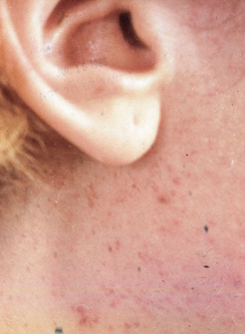
Post-emetic purpura (“mask phenomenom)
Cutis, 1986

Slide 34
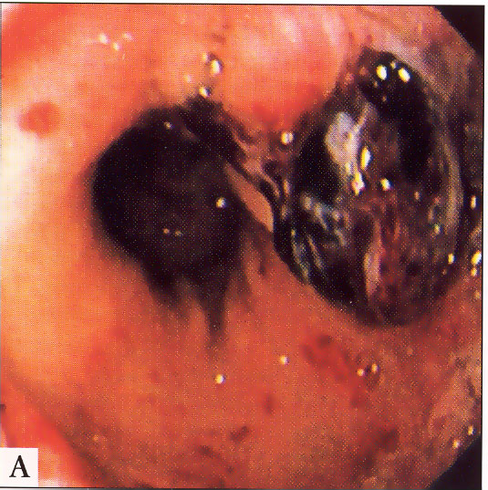
Mallory-Weiss tear with clot

Slide 35
Two tears: one at 7 o’clock opposite other tear at 1 o’clock

Slide 36
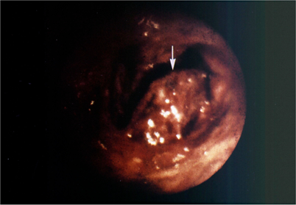
Esophageal hematoma secondary to forceful emesis
Lumen
←mass
Digestive Diseases and Sciences 26: 1019, 1981

Slide 37
Treat Complications: Metabolic
Alkalosis
Retention of HCO3 and volume contraction
Hypokalemia
Renal K loss, GI K loss, reduced intake K loss
Note: those with uremia or Addison’s may have normal or even high K despite vomiting
Hypochloremia
GI chloride losses
Hyponatremia
Free water retention 2/2 volume contraction

Slide 38
Drugs with anti- emetic properties and known mechanisms
Antihistamines, e.g., meclizine (Antivert^{R})
esp. for vestibular disorders
Anticholinergics, e.g., scopolamine (Transderm Scop^{R}, Donnatal^{R})
esp. for vestibular and GI disorders
Dopamine antagonists, e.g., metoclopramide (Reglan^{R}) or prochlorperazine (Compazine^{R})
esp. for GI disorders
Selective serotonin-3 (5HT₃) RAs, e.g., odansetron, granisetron, dolasetron
esp. to prevent chemotherapy-induced nausea/vomiting

Slide 39
Drugs with multiple anti-emetic properties
Multiple mechanisms of action:
Promethazine (Phenergan^{R})
dopamine antagonist
H1 antihistamine
anticholinergic
CNS sedative
prevention of opiate-induced nausea and vomiting
Hydroxyzine (Atarax^{R}, Vistaril^{R})
H1 antihistamine
anticholinergic
CNS sedation
prevention of opiate-induced nausea and vomiting

Slide 40
Histamine H₁ receptor antagonists (e.g. cyclizine + many others)
Many agents in this class also exert significant blockade of muscarinic receptors that probably contributes to their activity
Used for prophylaxis and treatment of motion sickness and acute labyrinthitis
Action attributed to blockade of H₁ receptors in vestibular nuclei, nucleus of the solitary tract and area postrema
Generally cause CNS depression and sedation – drowsiness may affect performance of skilled tasks

Slide 41
Dopamine receptor antagonists (e.g. domperidone and metoclopramide)
Complex mechanism of action
Centrally block dopamine D₂ receptors in the CTZ
Peripherally exert a prokinetic action on the oesophagus, stomach and intestine
Domperidone does not cross the blood brain barrier and is less likely to result in the many unwanted effects of metoclopramide (e.g. disorders of movement (extrapyramidal effects))
Not effective against motion sickness
Phenothiazines – which owe part of their action to dopamine D₂ blockade – are used for severe nausea and vomiting

Slide 42
Muscarinic acetylcholine receptor antagonists (e.g. hyosine /scopolamine)
Used for prophylaxis and treatment of motion sickness (can be delivered by transdermal patch)
Probably block muscarinic acetylcholine receptors at multiple sites (e.g. vestibular nuclei, nucleus of the solitary tract, vomiting centre)
Direct inhibition of G.I. movements and relaxation of the G.I. tract may contribute (modestly) to anti-emetic effects
Have numerous unwanted effects resulting from blockade of the parasympathetic ANS (e.g. blurred vision, urinary retention, dry mouth) and centrally-mediated sedation

Slide 43
Symptom relief: 5HT3 Antagonists
Useful for certain forms of chemotherapy related nausea
May have other special uses:
In CTZ related nausea, where dopamine blockade contraindicated
(Parkinson’s Disease)
? Other refractory CTZ related causes
? In certain GI cases
? Bowel Obstruction
? Radiation Enteritis
Currently very expensive

Slide 44
Symptom relief – Selective 5HT3 receptor antagonists
Ondansetron (granisetron, tropisetron, dolasetron, palonosetron)
4-8mg QD or BID
Liver disease: maximum 8mg daily
IV, PO, SL; Transdermal granisetron (Europe); PO film in trials
SE: minimal; constipation 5-10% of patients
Watch QT interval; contraindicated in those at risk for torsades
Reduces tramadol efficacy
Many favorable studies used as prophylactic
2 Randomized controlled trials in advanced cancer
Tropisetron >effective than metoclopramide or chlorpromazine
No sig difference in ondansetron, metoclopramide and placebo for opioid-induced nausea
Uncontrolled case series
Ondansetron as second-line agent was effective in 80% of pts

Slide 45
Symptom relief - Corticosteroids
Act centrally, but primary action unknown:
Reduction of BBB permeability to toxins
Inhibition of enkephalin release in brainstem
Depletion of GABA stores in medulla
Studies have shown efficacy rates of <20% to 75%
Bowel obstruction
Chemo-induced nausea
Raised intracranial pressure
Second-line for chronic nausea
SEs: hiccups
Dexamethasone
4-8mg daily (nausea); otherwise up to 16mg daily (BO)

Slide 46
Symptom relief - Octreotide
Somatostatin analogue
Refractory bowel obstruction
Reduces secretions from bowel and pancreas
Reduces GI motility
Causes vasoconstriction
Analgesic effects: partial mu-opioid agonist
100mcg SQ tid or 100-600mcg IV daily
SE: skin reaction, cramps, N&V, diarrhea, constipation, gallstones, HA, bradycardia, QT prolongation
Caution: DM , RF, endocrinopathies, hepatic dx

Slide 47
Symptom relief – Non-pharm
Diet restrictions
Avoid fatty, spicy, highly salty foods
Behavioral approaches
Distraction, relaxation, guided imagery,
Massage
Foot massage
Acupuncture
Studies show effectiveness on chemo-induced nausea and anticipatory nausea

Slide 48
Symptom relief – Nonsurgical procedures
Advanced cancer – 3% present with BO
Bowel CA and Ovarian CA lead the way
PEG - success rate for placement – 89-100%
Complications: ascites/leakage 9%; infection; obstruction; bleeding; tube obstruction; tube migration
Small study 64% reported improvement of nausea, vomiting, insomnia, mood, weakness and concentration after 7 days (symptom distress scale)
NGT – short term
SE: poor tolerance; restriction in activity; pain; altered body image
complications: aspiration; hemorrhage; gastric erosion; alar necrosis; sinusitis; otitis
Stents
Colonic decompression tube

Slide 49
Summary 1
Nausea and vomiting are features of many GI and non-GI diseases and disorders.
Treatment of nausea and vomiting should initially focus on replacing volume and electrolyte deficits. Later on, nutritional deficits must be addressed.
Nausea and vomiting can cause several life-threatening GI and non-GI complications.

Slide 50
Summary 2
Elucidation of the cause is often possible, and treatment of the underlying cause will usually be successful.
Effective symptomatic therapies for nausea and vomiting are available when the cause is unclear or when the treatment of the underlying cause takes time to work.

