Slide 1
GI & Hep disease Burden in Iran present and future For Medical Residents Shariati Hospital 8th Day 1399
Reza Malekzadeh M.D
Professor of Medicine
DDRI/TUMS

Slide 3
Common diagnosis for GI disorders in outpatient clinic Tehran 1395
1 | GERD | 2620 | 32% | K21
2 | IBS | 2022 | 25% | K58
3 | DU | 1130 | 14% | K26
4 | Dyspepsia | 909 | 11% | K30
5 | CHB | 581 | 7% | B18.0
6 | UC | 365 | 4% | K51
7 | Cirrhosis | 331 | 4% | K74
8 | Gastrodeodenitis | 275 | 3% | K29
9 | NAFLD | 231 | 3% | K76
10 | Crohn’s | 207 | 2% | K50

Slide 4
Time trends of gastro-esophageal reflux disease (GERD) and peptic ulcer disease (PUD) in Dyspeptic patient in Tehran
Sepanlue ,Malekzadeh MEJDD 2011

Slide 5
Digestive Diseases during 2000-2009 in Shariati Hospital Tehran, Iran
 | Diagnosis | ICD 10 Code | 2000-2004 Number (%) | 2005-2009 Number (%)
1 | Cirrhosis based on HBV | K74(B18.1) | 393 (21.73) | 254 (11.15)
2 | Cryptogenic Cirrhosis | K74.6 | 210 (11.60) | 239 (10.49)
3 | CBD Stone | K80.5 | 126 (6.96) | 233 (10.22)
4 | GI Bleeding | K92.2 | 149 (8.23 | 204 (8.95)
5 | Cirrhosis based on AIH | K75.4 | 124 (6.85) | 136 (5.97)
6 | Cirrhosis based on HCV | K74(B18.2) | 112 (6.19) | 137 (6.01)
7 | Cholangitis | K83 | 61(3.37) | 158 (6.93)
8 | Cholangiocarcinoma | C22.1 | 59(3.26) | 114 (5)
10 | Ulcerative Colitis | K51 | 73 (4.03) | 90 (3.95)
11 | Duodenal Ulcer | K26 | 79 (4.36) | 76 (3.33)
12 | Acute Pancreatitis | K85 | 46 (2.54) | 106 (4.65)
13 | Pancreatic Cancer | C25 | 31 (1.71) | 104 (4.56)
14 | Gastric Ulcer | K25 | 65 (3.59) | 52 (2.28)

Slide 6
تعداد کل موارد مرگ در ایران در هر دو جنس در 2017 به تفکیک علت:380,000 مرگ در ایران

Slide 7
تعداد موارد مرگ در ایران در هر دو جنس در 2017 به تفکیک علت: 380 هزار مرگ در ایران

Slide 8
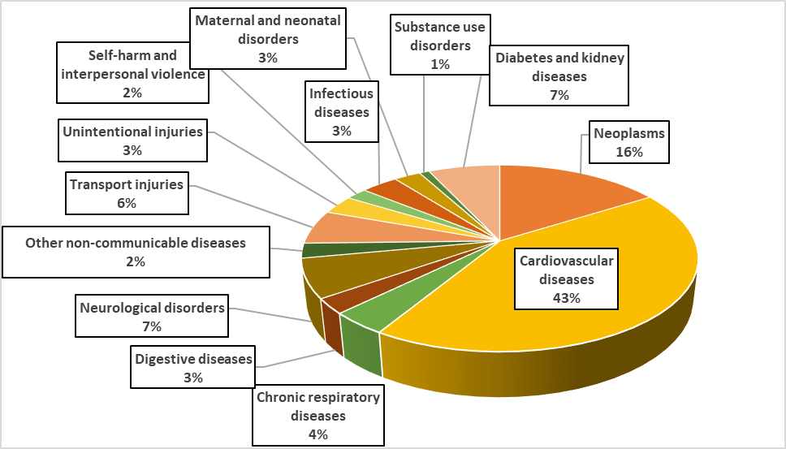
Deaths in Iran, both sexes, 2017

Slide 9
تعداد موارد مرگ زودرس: مرگهای زیر 70 سال 17700 مرگ (47%)

Slide 10
تعداد موارد مرگ خیلی زودرس: مرگهای زیر 50 سال: 85000 مرگ(22% )

Slide 11
علل122000 مرگ زودرس زیر 70سال در ایران

Slide 12
علل85000 مرگ خیلی زودرس زیر 50 سال در ایران

Slide 14
در صد مرگ های زودرس گوارش و کبد در ایران در سال 1394
درصد مرگ های زیر 50 سال | درصد مرگ های زیر 70 سال | تعداد کل مرگ ها
17% | 59% | 31835 | کل بیماریهای گوارش و کبد
13% | 58% | 19876 | سرطان های دستگاه کوارش و کبد
22% | 64% | 5150 | سیروز کبدی
32% | 77% | 967 | هپاتیت ها
20% | 53% | 6250 | عفونتها و سایر بیماریهای گوارش و کبد

Slide 15
Subgroups of GI-HEP Disease Burden
Gi Disease
Liver Disease
Digestive and Liver cancers

Slide 16
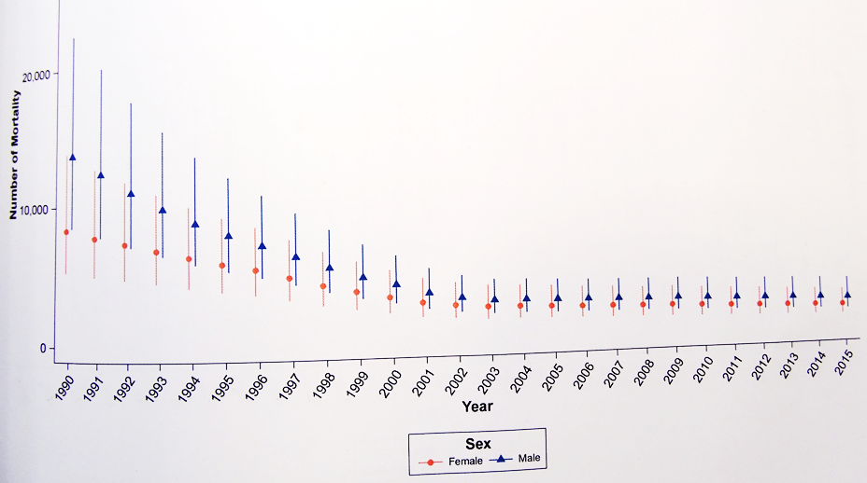
تعداد مرگ ناشي از بيماري هاي گوارشي

Slide 17
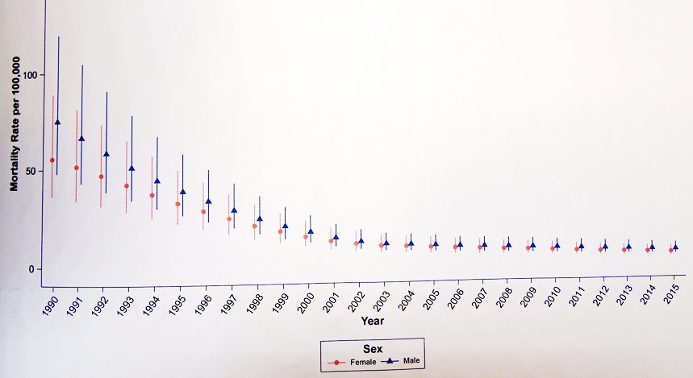
ميزان مرگ استاندارد شده سني ناشي از بيماري هاي گوارشي

Slide 18
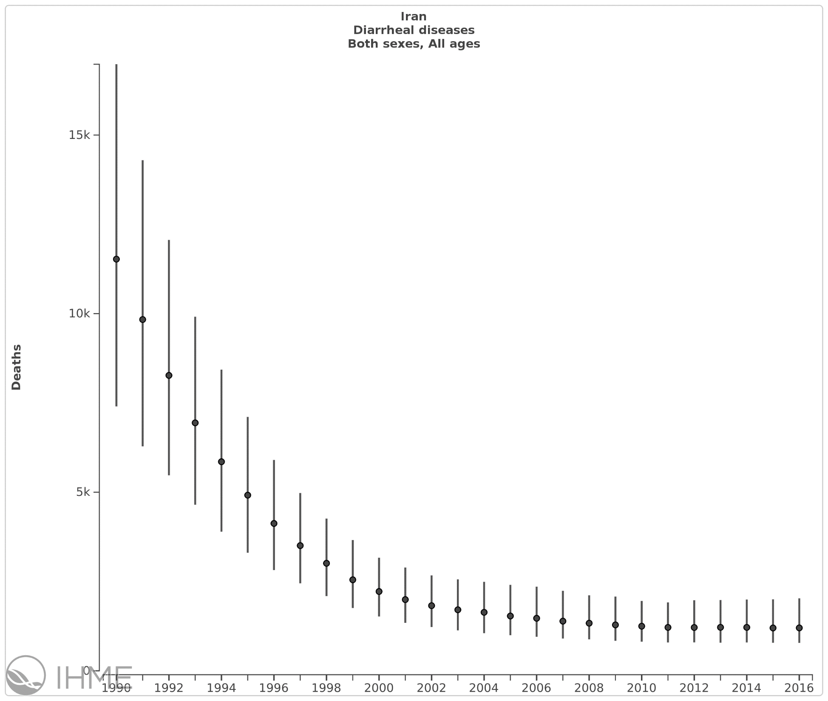
Number of deaths in both sexes all ages Diarrhea

Slide 19
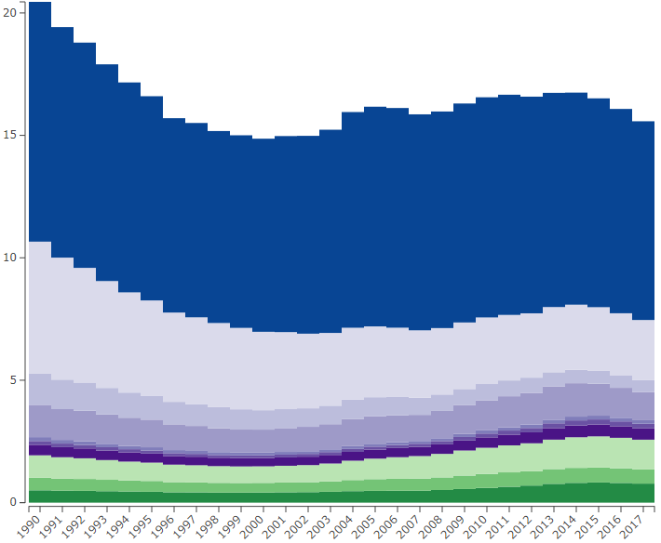
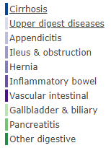
Age-standardized death rate of digestive diseases in Iran both sexes

Slide 20
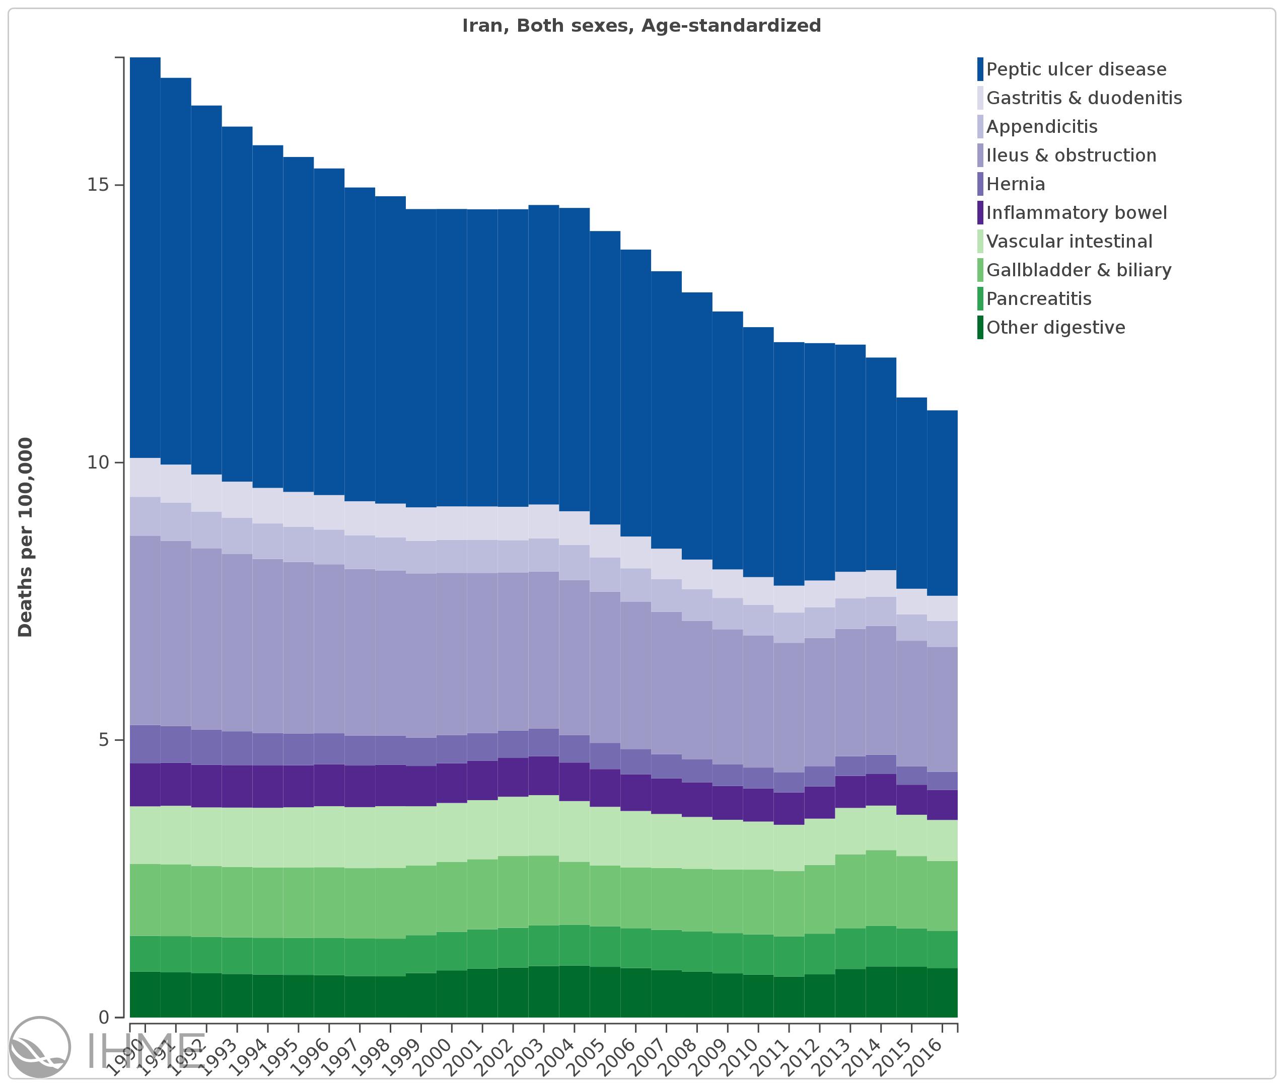
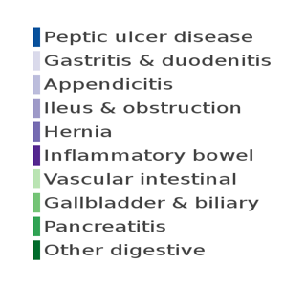

Slide 21
در صد مرگ های زودرس سیروز در ایران در سال 1394
درصد مرگ های زیر 50 سال | درصد مرگ های زیر 70 سال | تعداد کل مرگ ها
22% | 64% | 5150 | کل سیروزها
20% | 64% | 1640 | سیروز ناشی از هپاتیت B
21% | 67% | 1090 | سیروز ناشی از هپاتیت C
28% | 78% | 310 | سیروز ناشی از الکل
23% | 60% | 2120 | سیروز ناشی از سایر علل

Slide 23
Burden of Liver Disease In Europe

Slide 24
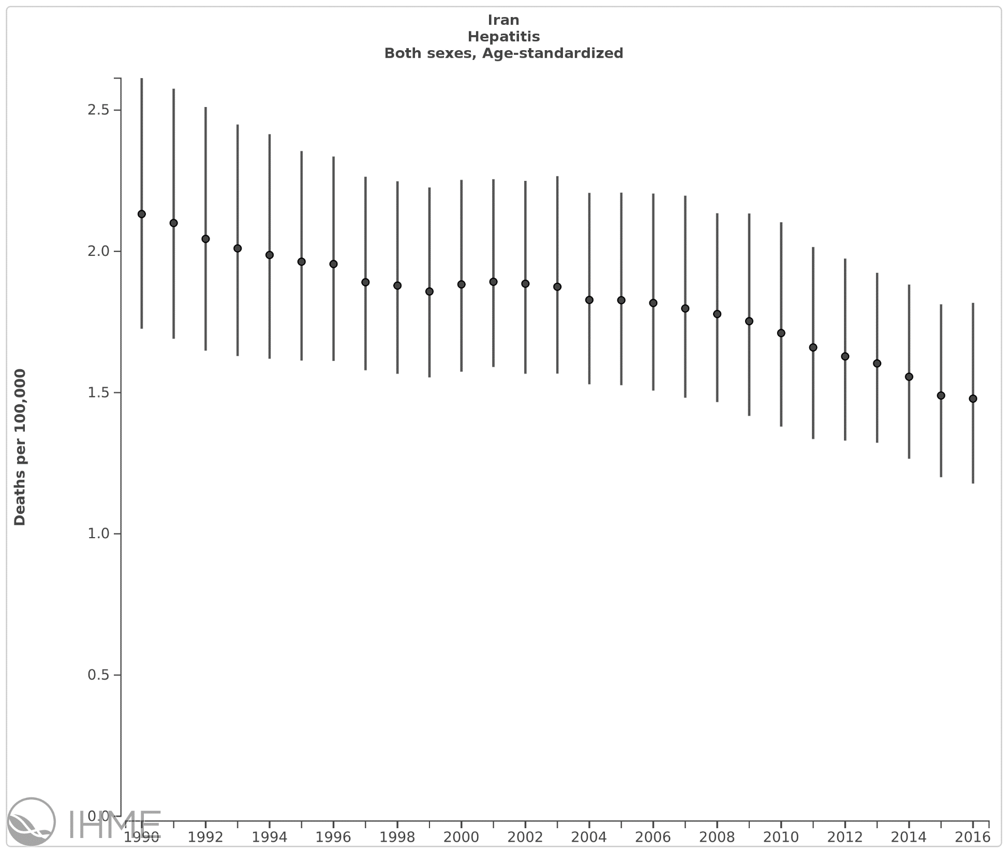
Age standardized mortality rate in both sexes of Hepatitis

Slide 25
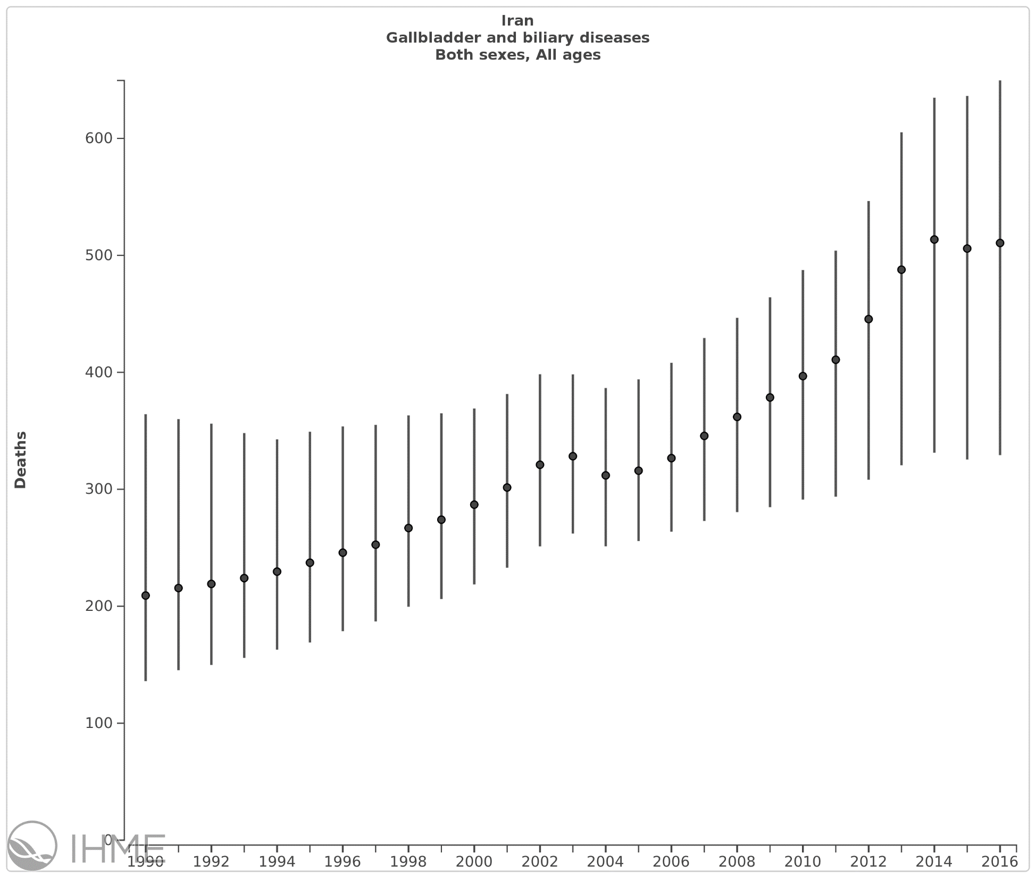
Number of deaths in both sexes all ages
Gall bladder and biliary disease

Slide 26
New Global Burden of Disease estimates for liver cirrhosis
Cirrhosis caused over a million deaths in 2010, with a further million due to liver cancer and acute hepatitis.
Cause-specific mortality data were very sparse for some regions, particularly in Africa, with no relevant mortality
data for 58/187 countries.
Liver disease involves infectious, malignant and chronic etiologies with overlapping symptoms.
Where available mortality data come from verbal autopsies, separating different types of liver disease is challenging.
Cirrhosis is a disease of rich and poor alike.
key public health risk factors such as alcohol consumption play an important role.
Obesity ,Diabetes with NAFLD and NASH
Risk-reduction strategies such as controlling the price of alcohol are being widely discussed.

Slide 27
Impact of Cirrhosis In Iran
Most common Cause of non-malignant death among GI diseases in Iran a minimum of 10,000 cases with 4500 death in Iran each year.
Most common reason for admission in GI in patients wards in Iran.
Significant suffering and finnational cost to the society.

Slide 28
Ratio of observations used in the Global Burden of Disease model to the number of cirrhosis deaths estimated for 2010,

Slide 29
Etiology of liver diseases among 1807 outpatient cases under care in a referral center in Tehran
Malekzadeh R,Dehpour AR Liver International 2008

Slide 30
Etiology of Chronic Hepatitis in Patients without CRF (N=412), DDRC OPD

Slide 31
Etiology of CH in 413 Patients Shariati Hospital Tehran 1371-1374
Viral----------------------------------- -61%
1- HBV----------------- 54%
2- HCV------------------7%
Non-Viral---------------------------- ---30%
1- AIH--------------- ----16%
2- PSC,PBC--------------6.5%
3- Alcohol,Drugs--------4.5%
4-NASH-------------------2.5%
5-Wilson’s----------------2.5%
Cryptogenic--------------------------- 9%

Slide 32
Non-Viral Hepatitis 162 Patients in Shariati Hospital
Non-Viral Hepatitis 162 Patients in SHARiati Hospital
AIH--------------- ----40%
Drugs---------------------8 %
NASH-------------------- 7 %
PSC------------------------7 %
Wilson’s---------------- --6 %
Alcohol,-------------------% 4
PBC------------------------4 %
Others---------------------24%

Slide 33
Treatable etiology of cirrhosis in Iran 2015
HBV 40%
NASH/NAFLD 20%
HCV 10%
AIH 10%
Alcohol,Wilson 2%
Others:PSC,PBC,Wilson’s,drugs ……

Slide 35
Prevalence In Iran
Very common
Most common cause liver disease in Iran
Become the most common cause of ELD in Next 40 years
Simple NAFLD probably in 30% of Iranians
NASH in 3%
Cryptogenic cirrhosis
A more common cause of liver transplant
Probably most common cause of cirrhosis in near future

Slide 36
Prevalence of NAFLD and NASH in Lean and obese
About 80% of NAFLD/NASH subjects we see in clinical practice are obese or overweight and less than 20 % are lean or normal weight people.
NAFLD was significantly less common in lean individuals (7% )than in the overweight or obese individuals (30% ).

Slide 37
NASH the most common liver disease in Iran
242 subjects (4.3%) were diagnosed with elevated ALT levels.
Among individuals with elevated ALT, 92%. Were diagnosed as NASH and 15 (6.2%) were diagnosed with either hepatitis B or hepatitis C
The overall weighted prevalence of presumed NASH was 2.9%.
Sohrabpour ,pourshams Merat Middle East Journal of Digestive Diseases 2010

Slide 38
Future Liver Disease in Iran: NAFLD related liver disease
We expect that in next 20 years while the HCV and HBV etiology decline but Iran will experience an increase in nonalcoholic fatty liver disease in the future, given the rise of obesity across the country.

Slide 39
Implementation measure to prevent the burden of Liver Diseases
Liver disease in Iran is a serious issue, with increasing cirrhosis and liver cancer death.
Child and adult obesity, and chronic infection with hepatitis viruses, which will in turn reduce the burden of liver disease.
Internists physician should be prepared

Slide 40
Cryptogenic cirrhosis 5–30% of cirrhosis cases still lack a definite aetiology.
Despite significant diagnostic advances in the last several decades, approximately 5–30% of cirrhosis cases still lack a definite aetiology.
Direct effect, telomere shortening secondary to telomerase gene mutations, also increases the risk of cirrhosis development in patients with chronic liver disease of different aetiologias

