Slide 1
Cirrhosis
Most common Liver Disease in Iran
GI Fellow 2020
Reza Malekzadeh
Professor of Medicine
TUMS/DDRI/Shariati Hospital

Slide 3
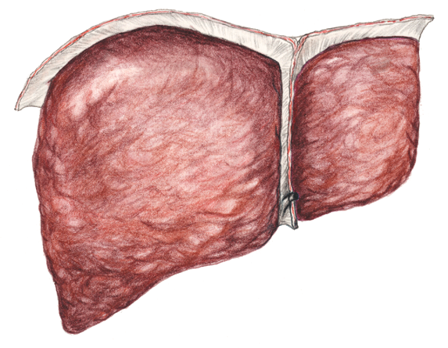

Slide 4
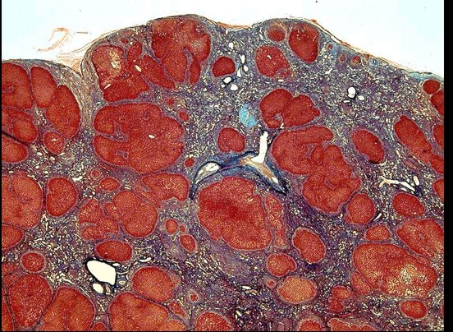

Slide 5
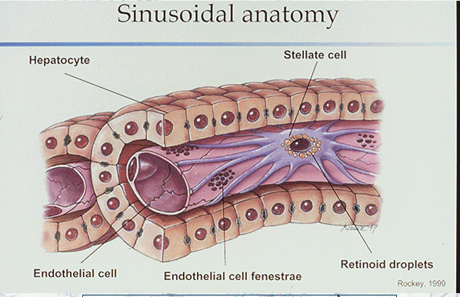

Slide 6
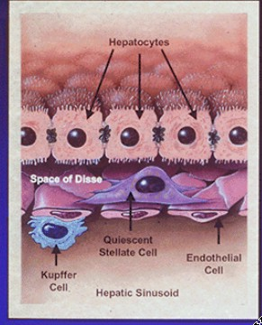

Slide 7
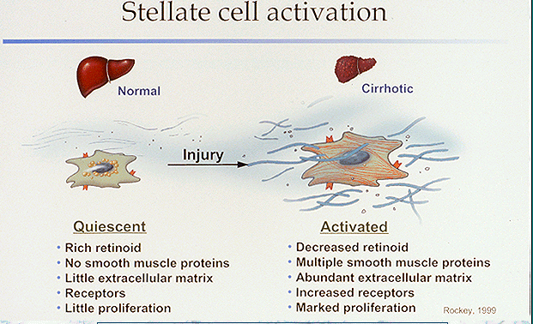
Notes:
Cellular and matrix alterations in the space of Disse are critical early events in the pathogenesis of hepatic
fibrosis. The activation of lipocytes, characterized by proliferation and increased fibrogenesis, is associated with
the replacement of the normal low-density matrix with a high-density matrix. These alterations are likely to
underlie, at least in part, the loss of both endothelial fenestrations (pores) and hepatocytic microvilli typical of
chronic liver injury. Adapted from Bissell3 with the permission of the author and the publisher.

Slide 8
Impact of Cirrhosis In Iran
Most common Cause of non-malignant death among GI diseases in Iran a minimum of 13,000 cases with 5400 death in Iran each year.
Most common reason for admission in GI in patients wards in Iran.
Significant suffering and finnational cost to the society.

Slide 9
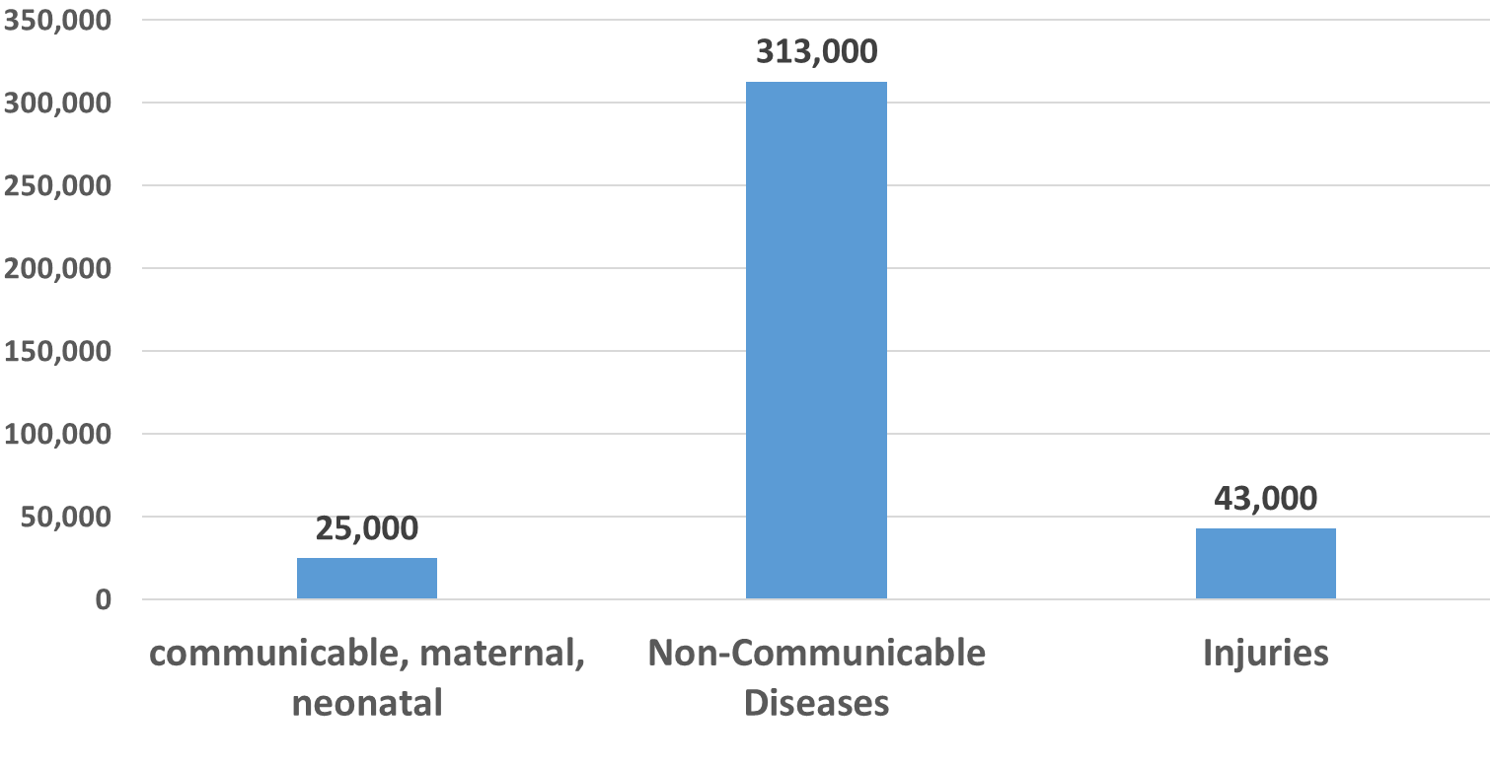
The total number of deaths in both sexes in 2017 in Iran by causes: 380 thousands

Slide 10
The number of premature deaths under 70

Slide 11
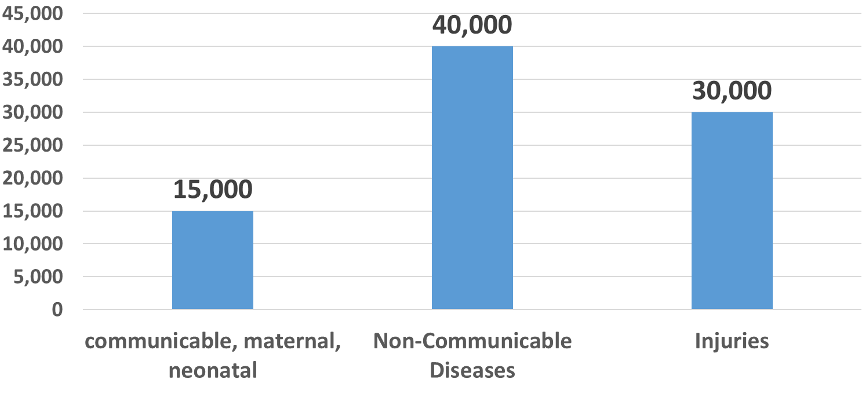
The number of premature deaths under 50

Slide 12
NCD deaths, both sexes, Iran, 2017
 | All ages | < 50 years | < 70 years
Non-communicable causes | 313 thousands | 40 thousands (13%) | 122 thousands (39%)
Cardiovascular diseases overall | 161 thousands | 12 thousands (7%) | 52 thousands (32%)
Ischemic heart disease | 96 thousands | 7 thousands (7%) | 32 thousands (34%)
Stroke | 36 thousands | 2.5 thousands (6%) | 11 thousands (29%)
Neoplasms | 61 thousands | 11 thousands (18%) | 34 thousands (56%)
COPD | 15 thousands | 1,200 (8%) | 4,800 (32%)
Diabetes | 16 thousands | 1,000 (6%) | 7,100 (44%)
CKD | 10 thousands | 1,160 (11%) | 3,800 (38%)
Chronic Liver Disease | 5,400 | 1,000 (19%) | 3,000 (56%)

Slide 13
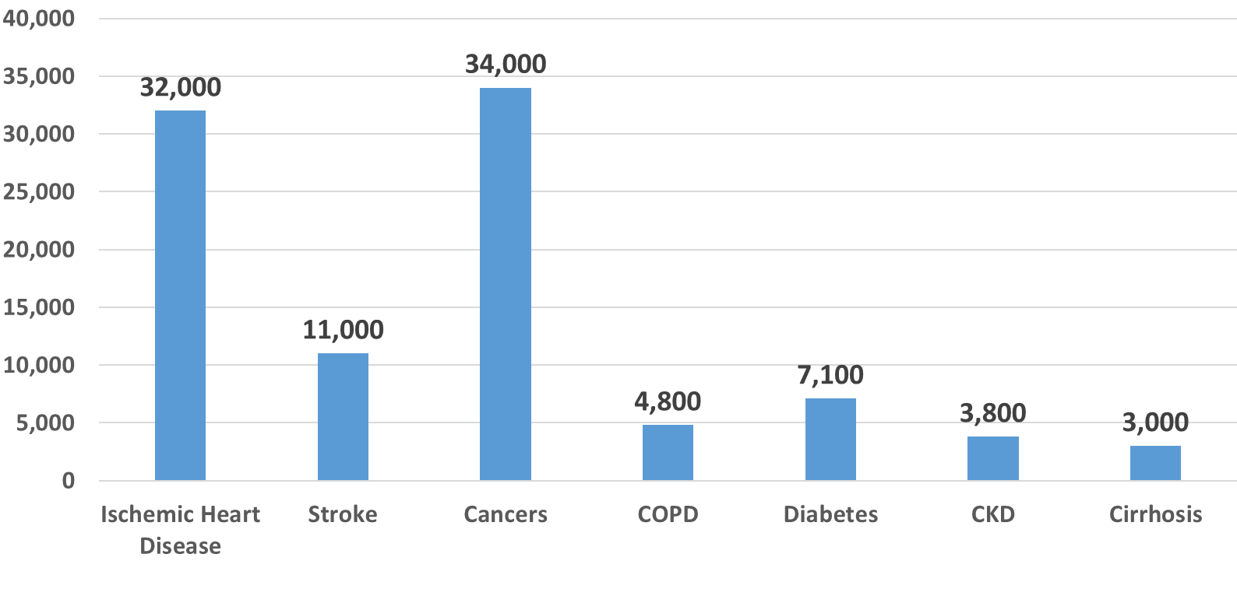

The number of premature deaths under 70 by cause

Slide 14
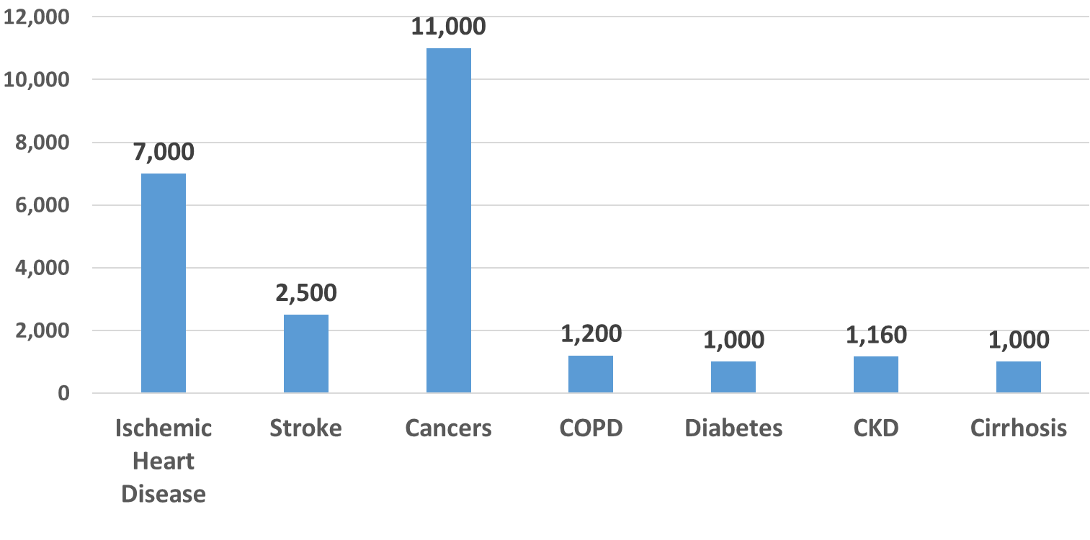
The number of premature deaths under 50 by cause

Slide 15
Most Common Outpatient Gastrointestinal Diagnoses in Iran, 2000-2004*
Diseases | Number of Patients | %
GERD | 5240 | 33
IBS | 4043 | 25
NUD | 1818 | 11
DU | 1239 | 8
Malekzadeh R,Ganji A et al in press

Slide 16
Most Common Inpatient Gastrointestinal Diagnoses in Shariati Hospital, 2000-2004
Disease | Number | %
Hepatitis &Cirrhosis | 1568 | 63
Peptic Ulcer +UGI bleeding | 364 | 15
GB stone Diseases | 245 | 10
Colon &Rectal Cancer | 134 | 5.4
IBD | 118 | 5

Slide 17
Main Causes of 397/5880 Death during 2000-2209 in Shariati GI ward
HBV-induced liver cirrhosis (17.38%)
Cryptogenic- (NAFLD) induced cirrhosis (10.83%)
Non-variceal gastrointestinal bleeding (7.55%)
HCV-induced cirrhosis (5.54%)
Cholangiocarcinoma (5%)
Autoimmune-induced cirrhosis (4.785)
Liver metastasis (3.52%)
Gastric cancer (3.27%)
Sepsis and septic shock (3.02%)
Acute LD (2.77%)
Ascending cholangitis (2.77%)

Slide 18
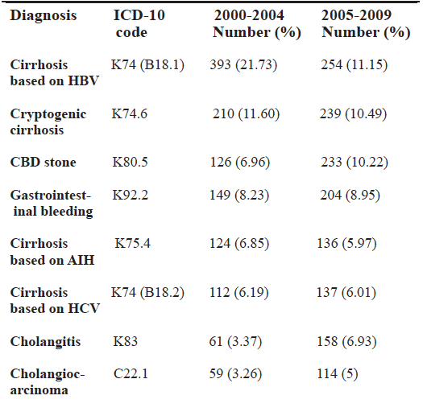
Common GI and Liver Disease in Shariati GI ward 2000-2009

Slide 19
Etiology of Cirrhosis
Non-Biliary
1-Viral: HBV,HCV,HBV+HDV
2-NFLD/NASH future most common aetiology of cirrhosis
2-Non-Viral: AIH, Metabolic liver disease (Wilson..)
Biliary
1-PBC
2-PSC
3-AIC (Overlap Syndrome)

Slide 20
Etiology of CH (Cirrhosis) in 413 Patients Shariati Hospital Tehran 1371-1374
Viral----------------------------------- -61%
1- HBV----------------- 54%
2- HCV------------------7%
Non-Viral---------------------------- ---30%
1- AIH--------------- ----16%
2- PSC,PBC--------------6.5%
3- Alcohol,Drugs--------4.5%
4-NASH-------------------2.5%
5-Wilson’s----------------2.5%
Cryptogenic--------------------------- 9%
*. Ziyad-Alizadeh B, H, Malekzadeh R, et al. Frequency of different causes of chronic hepatitis in patients Govaresh 1998; 13/14: 13-23.

Slide 21
Etiology of Cirrhosis in 170 Patients
Shariati Hospital 1371-1374
HBV 61%}
Wilson 15% }
AIH 14% } 90% Treatable
HCV 6%
Alcohol 6%
Budd-Chiari 3%
PSC 3%
PBC 2%
Azimi K , Malekzadeh R.et al Causes of cirrhosis in cirrhotic patients in Shariati hospital. Govaresh, 2002; 37: 19-26.

Slide 22
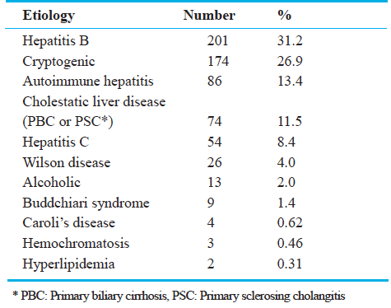
Etiologies of liver disease among patients on liver transplant waiting list in Shiraz from April 2004 to March 2007. ( N = 646)
Middle East Journal of Digestive Diseases, 2009; 1(2): 63-67

Slide 23
Irreversibility of Cirrhosis
This belief was established more than half a century ago, when:
The diagnosis of cirrhosis was made clinically on the basis of signs of end-stage liver disease, such as ascites, muscle wasting, variceal bleeding,jaundice, and encephalopathy.
These features continue to indicate a poor prognosis in the absence of liver transplantation and are still used to classify the severity of liver disease in patients who are awaiting transplantation.

Slide 24
Main Clinical Subtypes
Compensated
Decompensated

Slide 25
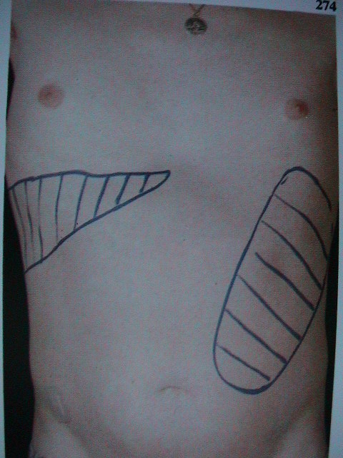
Compensated

Slide 26

Compensated

Slide 27
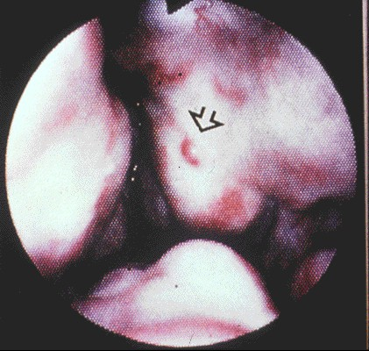

Slide 28
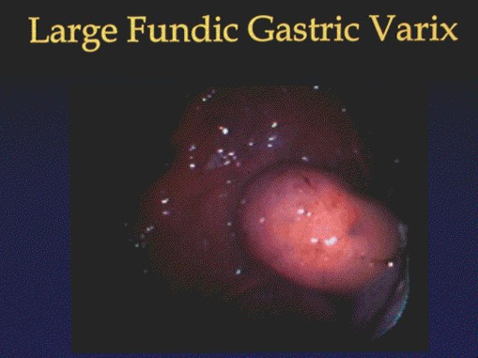

Slide 29
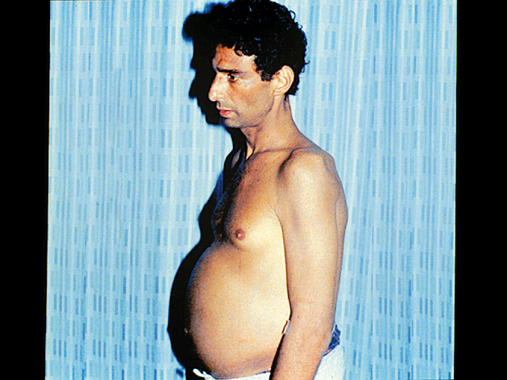
Decompensation

Slide 30
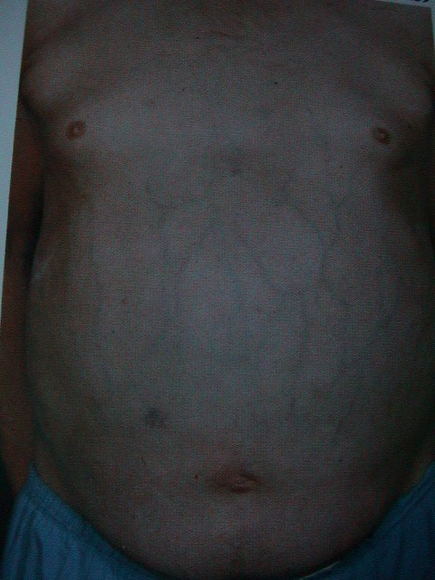
Decompensated

Slide 31
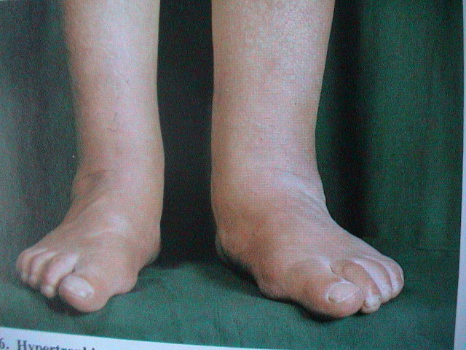

Slide 32
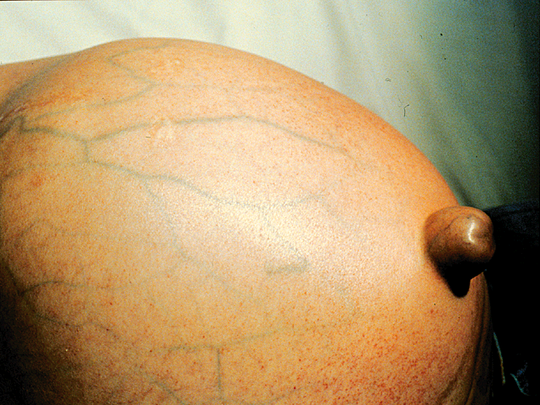

Slide 33
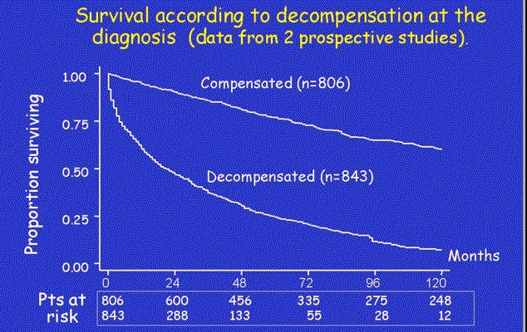

Slide 34
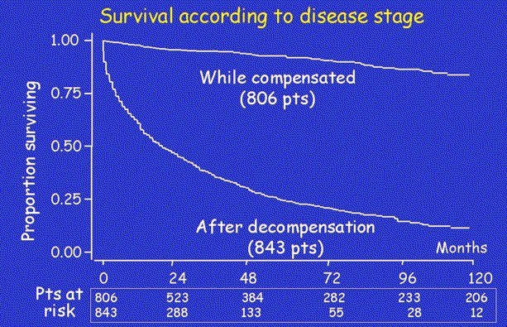

Slide 35
Reversibility of Cirrhosis

Slide 36
Reformulation of the concept of cirrhosis
Reformulation of the concept of cirrhosis from a static to a dynamic one, creating a template for further refinement of this concept in the future.

Slide 37
Reasons for redefining Cirrhosis
Advance in treatment of chronic liver disease(e.g., antiviral, antifibrotic stem cell therapies and transplantation).
Inadequacy of a simple one-stage description for advanced fibrotic liver disease has become increasingly evident.

Slide 38
Basis for reformulation
1-Anatomical-Pathological .Metavir staging F0-F4.
2- Clinical Context: compensated and decompensated
3- Hemodynamic Context: HVPG measurement
4-Liver stiffness Measurement: TE score
5- Biological Context: Matrix modification with cross-linking, elastin-rich scars, vascular extinction and septal neovascularization.

Slide 39
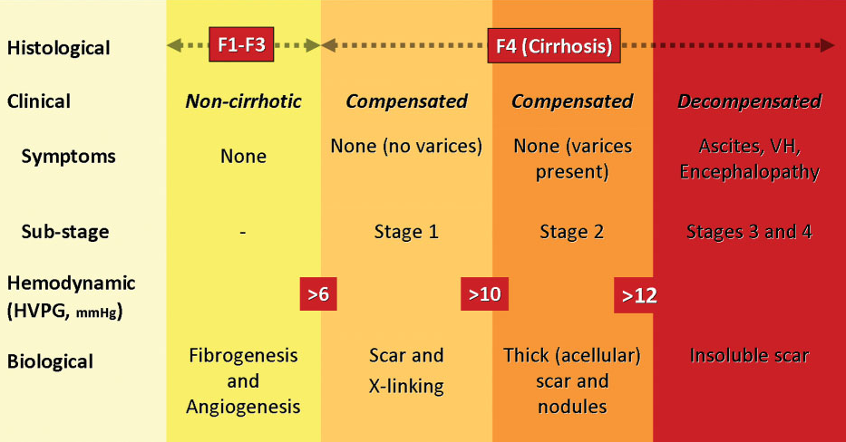
Classification of chronic liver disease based on histological, clinical, hemodynamic, and biological parameters
Garcia- Tsao G et al Hepatology 2010

Slide 40
Therapeutic strategies for hepatic fibrosis
Remove injurious stimuli: D/C Alcohol, RX of HBV, HCV, Wilson’s ,Hemochromatosis…
Suppress hepatic inflammation: Steroid in AIH, Alcohol, TNF-alfa, UDCA
Down regulate satellite cell activation: Cytokine-directed therapy(TGF-beta antagonists Endothelin receptor antagonists Hepatic growth factor) .
Promote matrix degradation: Target degradation of interstitial-type matrix, rather than basement membrane-type matrix : TGF-beta antagonists, relaxin

Slide 41
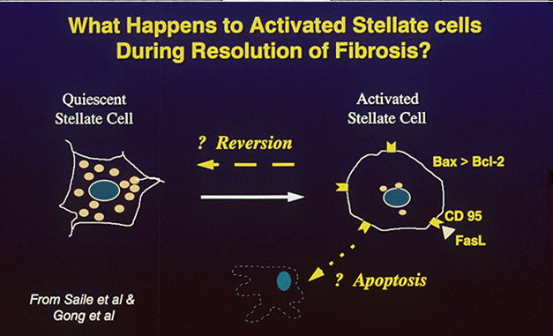

Slide 42
Experience at Shariati Hospital liver clinics

Slide 43
Chronic HBV hepatitis
Rx course:1375-1380

Slide 44

1375stage6
1379stag2
1380stage0
There is the possibility that the changes could have been accounted for by variation in sampling on liver biopsy?!

Slide 45
Chronic HCV heptitis
Rx course:1377-1380

Slide 46

1377-stage3
1377-stage3
1380-stage0

Slide 47
AUTOIMMUNE HEPATITIS
Rx course:1377-1380

Slide 48
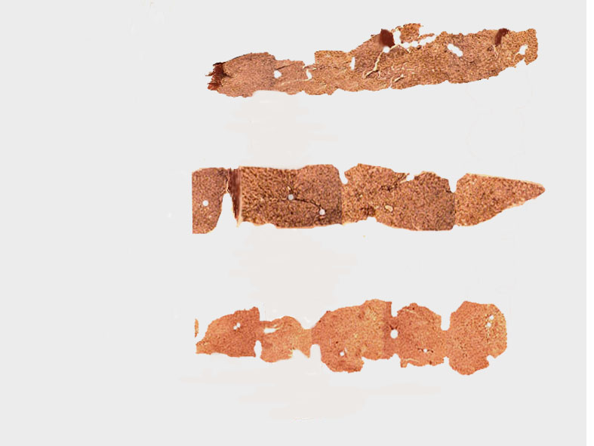
1377stage3
1379stage2
1380stage0

Slide 49
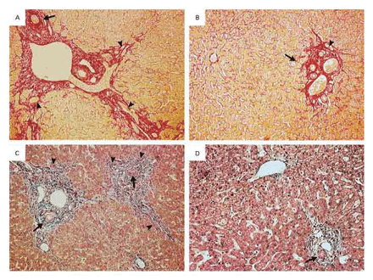
New Engl J med 2001;344,418
Notes:
Histologic Features of Liver-Biopsy Specimens Obtained during and after Biliary Decompression in Two Patients with Stenosis of the Common Bile Duct
Due to Chronic Pancreatitis.
Panel A shows a specimen obtained from Patient 1 during biliary compression (picrosirius stain, x80). The portal tract is enlarged by edematous fibrosis, with
periportal ductular proliferation (arrowheads). The interlobular bile duct is surrounded by dense fibrosis (arrow). Panel B shows a specimen obtained from the same
patient 30 months later (picrosirius stain, x70). The portal fibrosis is mild, with faint ductular proliferation (arrowhead). The structure of the interlobular bile duct is
preserved (arrow). Panel C shows a specimen obtained from Patient 5 during biliary decompression (chromotrope aniline blue, x50). The portal tracts are enlarged,
with edematous fibrosis and pronounced ductular proliferation (arrowheads). The interlobular bile ducts are surrounded by fibrosis (arrows). Panel D shows a
specimen obtained from Patient 5 32 months after biliary decompression (chromotrope aniline blue, x120). The portal fibrosis is mild, and the interlobular bile duct is
normal (arrow).

Slide 53
Preventing the progression of disease
Extensive fibrosis or cirrhosis in patients with well-preserved liver function should no longer be considered untreatable.
Both current and future therapies have the potential for preventing the progression of disease and facilitating endogenous mechanisms that lead to the degradation of extracellular matrix and the regression of fibrosis
1.Malekzadeh et al Reversibility of cirrhosis in HBV J Clin Gastroel Hept 2004.
2.Malekzadeh et al Reversibility of cirrhosis in autoimmune hepatitis.Am J Med2004

Slide 54
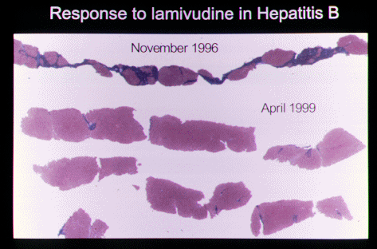

Slide 55
Regression of cirrhosis during treatment with Tenofovir for chronic hepatitis B: a 5-year open-label follow-up study
Patrick Marcellin et al
Lancet December 10, 2012 :140-6736(12)61425-1

Slide 56
Background
To assess the effects on fibrosis and cirrhosis of at least 5 years’ treatment with Tenofovir in chronic HBV infection.

Slide 57
Methods
After 48 weeks of randomized double-blind comparison (trials NCT00117676 and NCT00116805) of Tenofovir with adefovir, participants (positive or negative for HBeAg) were eligible to enter a 7-year study of open label Tenofovir treatment, with a pre-specified repeat liver biopsy at week 240.
Histological improvement (≥2 point reduction in Knodell necro-inflammatory score with no worsening ) and regression of fibrosis (≥1 unit decrease by Ishak scoring system).

Slide 58
HCC
Only 7 (7.3%) of the 96 patients with baseline cirrhosis developed hepatocellular carcinoma (HCC) between week 50 and 206 of therapy.
Far lower than the previously reported annual incidence of 2-6% in
untreated cirrhotic patients.

Slide 59
Baseline Cirrhotic Patients
At baseline, 133 (38.7% of the 344 patients) had Ishak fibrosis scores ≥4, including 96 (28% of 344) had cirrhosis (Ishak fibrosis score ≥5).

Slide 60
74% Reversibility overall
71 (74%) of the 96 patients with liver cirrhosis at baseline had a reduction in fibrosis >2 unit (except 1 patient) and were no longer cirrhotic at year 5.

Slide 61
90% Reversibility in non-obese
Excluding patients with body-mass index (BMI) ≥25 kg/m2, which was found to be a significant negative predictor of cirrhosis regression, 29 (90%) of 32 patients with normal BMI were no longer cirrhotic.

Slide 62
Results
Of 641 patients who received randomised treatment, 585 (91%) entered the open-label phase, and 489 (76%) completed 240 weeks.
348 patients (54%) had biopsy results at both baseline and week 240.
304 (87%) of the 348 had histological improvement, and 176 (51%) had regression of fibrosis at week 240 (p<0・0001).

Slide 63
Regression of cirrhosis
Of the 96 (28%) patients with cirrhosis (Ishak score 5 or 6) at baseline, 71 (74%) no longer had cirrhosis (≥1 unit decrease in score) 5 years later
Three of 252 patients without cirrhosis at baseline progressed to cirrhosis at year 5 (p<0・0001).

Slide 64
Safety
Virological breakthrough occurred infrequently and was not due to resistance to Tenofovir .
The safety profile was Favourable: 91 (16%) patients had adverse events but only nine patients had serious events related to the study drug.

Slide 65
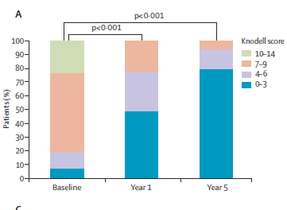
Distribution of Knodell necro-inflammatory scores in 348 patients on Tenofovir treatment with results available at each time point

Slide 66
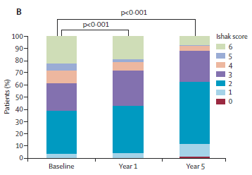
Distribution of Ishak fibrosis scores in 348 patients on Tenofovir treatment with baseline and year 5 data, and 344 with data for all three time points.

Slide 67
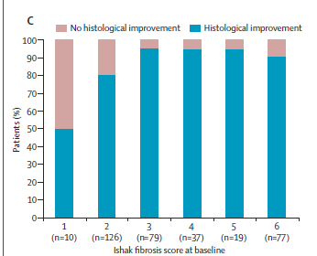
Histological response at year 5 according to baseline Ishak fibrosis scores for 348 patients with data available at baseline and year 5.

Slide 68
Conclusions
In patients with chronic HBV infection, up to 5 years of treatment with Tenofovir TDF was safe and effective.
suppression of HBV can lead to regression of fibrosis and cirrhosis.

Slide 69
Treatable etiology of cirrhosis in Iran
HBV 40%
NASH/NAFLD 20%
HCV 10%
AIH 10%
Alcohol,Wilson 2%
Others:PSC,PBC,Wilson’s,drugs ……

Slide 70
Reversibility Rate
AIH---------→ up to 50%
Biliary obstruction-→50%
HCV ---------------- →60%
HBV---------------- →70%

Slide 71
Irrevesibility of Cirrhosis
This belief was established more than half a century ago, when:
The diagnosis of cirrhosis was made clinically on the basis of signs of end-stage liver disease, such as ascites, muscle wasting, variceal bleeding,jaundice, and encephalopathy. These features continue to indicate a poor prognosis in the absence of liver transplantation and
are still used to classify the severity of liver disease in patients who are awaiting transplantation.

Slide 72
Advances in the treatment of liver diseases have made it increasingly apparent that medical treatment may be beneficial even for patients with advanced histologic changes, including cirrhosis. Furthermore, in some cases fibrosis and even frank cirrhosis have appeared to regress with treatment.
Bonis, PA, Friedman, SL, Kaplan, MM. Is liver fibrosis reversible?.
N Engl J Med 2001; 344:452

Slide 74
Maximizing Quality of Care in:
Chronic hepatitis and Cirrhosis

Slide 75
HBV chronic Liver Disease
Tenofovir Disoproxil Fumarate (TDF) 300 mg QD till HBSAG became Negative (Tenofovir Alafenamide (TAF) [Rotaf 25 mg tab] instead of Tenofovir in patient with elevated creatinine
Atorvastatin 20 mg QD Long term
Aspirin 80 mg QD Long term

Slide 76
HCV Chronic Liver Disease
Sofosfovir+ Daclatasvir (Sovodak) one tablet/day
x 3-6 months
Till HCV-RNA become negative
Atorvastatine 20 mg Long Term
Aspirin 80 mg Long Term

Slide 77
NAFLD/NASH
Exercise
Diet Ideal weight
Atorvastatin 20 mg QD Long term
Aspirin 80 mg QD Long term

Slide 78
Wilson's Disease
D-Pencillamin Long term
Vit B6

Slide 79
Important Management Goals in Cirrhosis
  Screening for varices
  Screening for HCC
  RX of possible HE, and SBP
  Consideration for transplant
Past view
Reversing the Process of Fibrogenesis
Novel Therapeutic Strategies

Slide 80
Natural History of Cirrhosis?
Stage 1 (no esophageal varices)
Stages 2 (varices)
Stage 3 (ascites)
Stage 4 (gastrointestinal bleeding)
Stage 5 (infections and/or renal failure)

Slide 81
Natural History of Cirrhosis with related 1 year mortality
Stage 1 (no esophageal varices)[1%]
Stages 2 (varices)[3.4%]
Stage 3 (ascites)[20%]
Stage 4 (gastrointestinal bleeding)[57%]
Stage 5 (infections and/or renal failure)[67%]

Slide 83
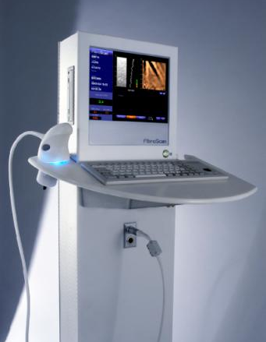
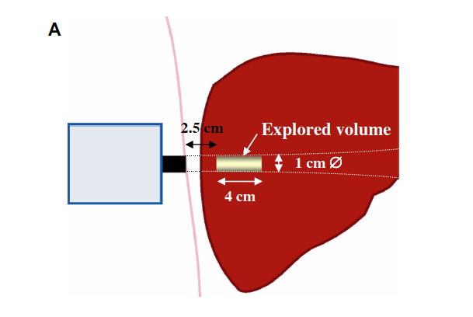
Liver Biopsy versus Transient Elastography
At least 100 times bigger than a liver biopsy sample
Liver biopsy; 10-30X1.2-2mm
or 1/50,000 of liver mass

Slide 84
Platlete Count

Slide 85
Primary Prevention Of Variceal Hemorrhage Is Important in Compensated Cirrhosis
Prevalence
Incidence/Y
Progression of size/Y
2 Ys incidence of bleeding
Risk of Death/bleeding
30%
5% to 10%
10% to 15%
24%
12% to 44%
Clinical Liver Disease, 2012; 1 (5): 147-150

Slide 86
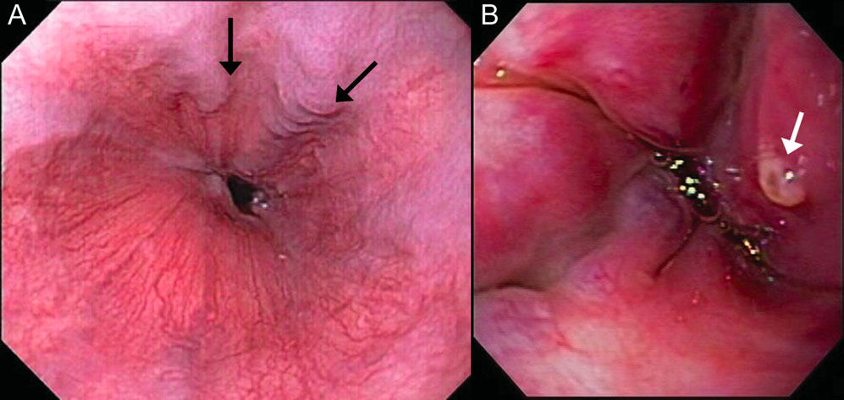

Slide 87
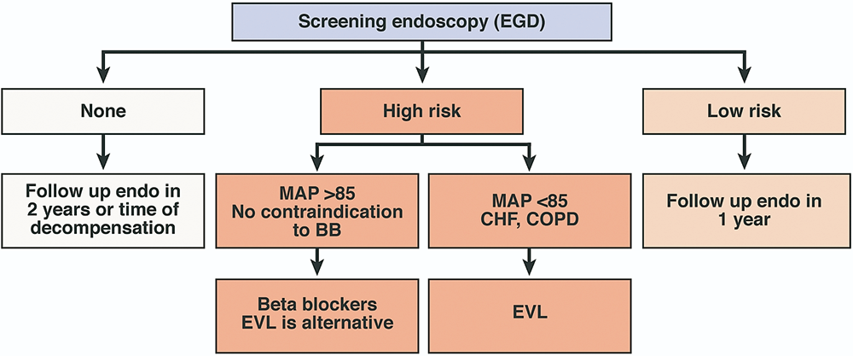
An Algorithm for the Primary Prophylaxis of Variceal Hemorrhage
HIGH RISK
Large varices > 5 mm diameter
Small varices
Red color sign
CTP class B/C
15 % /year risk of bleeding
1-2%/year risk of bleeding
5%/year risk of bleeding
MAP= (CO X SVR) + CVP
MAP ≅ DP + 1/3 (SP-DP)
1- de Franchis R, Clin Liv Dis 2001;5:645–663.
2- Garcia-Tsao G, Hepatology 2007;46:922–938.

Slide 88
NSBBs; Highly effective in 1 and 2nd Prevention
Carvedilol
NSBB + Alpha-1 blocker ➔➔➔➔ weak vasodilation on the intrahepatic circulation
  More effective than propranolol in reducing HVPG and hepatic vascular tone
  In one randomized study, was better than band ligation for primary prevention

Slide 89
Associated Portal-Vein Thrombosis Should be Considered
Worsening liver function, ascites, and bleeding
Incidence 16% per year in advanced disease
Treatment; on a case by- case basis
Effect of warfarin or low molecular weight heparin especially after eradication of bleeding varices
Garcia-Pagan JC, Valla DC. Portal vein thrombosis: a predictable milestone in cirrhosis? J Hepatol 2009;51:632-4.
DeLeve LD, Valla DC, Garcia-Tsao G. Vascular disorders of the liver. Hepatology 2009;49:1729-64.
HEPATOLOGY 2012;56:1983-1992

Slide 90
Compensated Cirrhosis
NSBBs
Statins
Lifestyle Changes
Specific therapies
Antibiotics, probiotics
Future therapies
Anticoagulants
Liver Cirrhosis;
Preventing
rather than
Treating its
Complications

Slide 91
Liver Cirrhosis;
New Therapeutic Paradigms
Lifestyle changes
Specific therapies; antivirals
Nonspecific therapies
  NSBBs
  Statins
  Antibiotics
  Anticoagulants

Slide 92
Preventing the progression of disease
Extensive fibrosis or cirrhosis in patients with well-preserved liver function should no longer be considered untreatable.
Both current and future therapies have the potential for preventing the progression of disease and facilitating endogenous mechanisms that lead to the degradation of extracellular matrix and the regression of fibrosis
1.Malekzadeh et al Reversibility of cirrhosis in HBV J Clin Gastroel Hept 2004.
2.Malekzadeh et al Reversibility of cirrhosis in autoimmune hepatitis.Am J Med2004

Slide 93
Skepticism
How the distorted liver parenchyma and altered blood flow in cirrhotic liver are reversible?

Slide 94
Vascular changes of cirrhosis are reversible
12-month lamivudine therapy reduced hepatic venous pressure gradient (HVPG) in 18 of 19 patients with cirrhosis or decreased ≥ 20% and <12 mmHg in 10 of 13 patients with baseline HVPG >12 mmHg.
Suggesting that vascular changes of cirrhosis are reversible in patients with virological and biochemical response

Slide 95
No emergence of tenofovir resistance
No emergence of tenofovir resistance observed in any patient during 100 weeks of treatment

Slide 96
When to Stop oral Therapy
HBeAg-Negative: Life Long term therapy
Loss of HBSAg with seroconversion to anti-HBs may be an acceptable endpoint
Notes:
l

Slide 97
Analogy to CVD risk factor therapy
Patients with HBeAg-Negative CBH on life long oral antiviral therapy with the goal of reducing the potential complications of cirrhosis or HCC are often reassured by the analogy of long-term treatment of hypercholesterolemia, hypertension, or diabetes mellitus to prevent stroke or heart disease.

Slide 98
Can HBV Infection Be Cured?
HBV is not curable but it is controllable
HBsAg seroconversion is the ultimate form of viral control
Notes:
98
HBsAg, hepatitis B surface antigen.
This slide emphasizes an important point, that hepatitis B is not curable but is controllable with our powerful agents. A number of different medications can be used, and clinicians should be focused on achieving undetectable HBV DNA in all patients. However, HBsAg seroconversion is the ultimate goal for our patients.

Slide 99
Tr
Treatment of HBV related irreversible Compensated and decompensated cirrhosis

Slide 100
New Therapeutic Paradigm for Patients With Cirrhosis
Lifestyle Changes
  Avoiding alcoholic beverages
  Vaccination (HBV, HAV, FLU, PNEUMOCOCCI)
  WT reduction; in obese and compensated cirrhosis
  Stop smoking
  Drink at least three cups of coffee per day
  Counseling and behavioral therapy? Needs trials
Specific therapies; antivirals
  Weight loss, increasing coffee consumption, supplementation with vitamin D, achieving good diabetic control, and use of statins could optimize outcomes with antiviral (esp HCV) treatment
Nonspecific therapies

Slide 101
Malnutrition is Prevalent in Cirrhosis
Up to 50-90% in advanced liver disease
Is an important prognostic factor.
Etiologic factors include
  Hyper-metabolism
  Fat Malabsorption
  Altered nutrient metabolism
  Anorexia and decreased intake
  Diuretics
KALLY CHEUNG et al CLINICAL GASTROENTEROLOGY AND HEPATOLOGY 2012;10:117–125

Slide 102
Fat-soluble vitamins (A, D, E, and K) Deficiency
In a study of 180 patients with PBC, 33%, 13%, 2%, and 8% had deficiencies in vitamins A, D, E, or K, respectively.
> 90% of cirrhotics have vitamin D deficiency and 29% have severe vitamin D deficiency (< 17.5 nmol/L).
Zinc & magnesium deficiency
Restricted intake of animal protein and treatment with diuretics
HCV infection is associated with decreased levels of vitamin B6 and folate

Slide 103
Energy requirement
Based on dry weight or determined ideal body weight, for patients with ascites 25 to 40 kcal/kg per day.
65% Carbohydrate
30% Fat
10% Protein

Slide 104
Carbohydrate
Restriction is not recommended despite high prevalence of TR and DM
Recommendations:
  Frequent meals and snacks
  45%–65% of caloric intake
  A late CHO meal at night
    reduces gluconeogenesis from protein breakdown, improves nutrition as shown in an RCT, and is an easy lifestyle change
Plank LD, et al. HEPATOLOGY 2008;48:557-566.
MMWR Morb Mortal Wkly Rep 2011;60:1-4.

Slide 105
!!!Dietary Modifications
If patients are able to eat more than 70 g protein per day without deterioration of mental status, no modification of their diet is necessary or effective.
In patients with borderline protein intolerance (60-70 g protein/d) a vegetable diet, or a diet rich in fiber may help to prevent hepatic encephalopathy

Slide 106
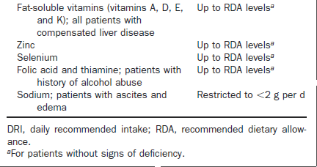
Micronutrient

Slide 107
Gastrointestinal bacterial overgrowth
25% of cirrhotic patients have small bowel bacterial overgrowth, which can promote intestinal wall permeability that results in bacteria translocation, secondary infections, and fat malabsorption with associated consequences.
Changes in microflora observed in patients with gastrointestinal bacterial overgrowth have been associated with minimal hepatic encephalopathy (MHE).

Slide 108
Compensated Cirrhosis
NSBBs
Statins
Lifestyle Changes
Specific therapies
Antibiotics, probiotics
Future therapies
Anticoagulants
Liver Cirrhosis;
Preventing
rather than
Treating its
Complications

Slide 109
Coffee ➔➔up-regulating glucuronidation
➔➔ antioxidant effects on the liver
Lower risk of ALT elevation among 5,944 individuals with high risk of liver injury
Significant reduction in risk of fibrosis in patients with NASH
Independent predictor of SVR to antiviral treatment among 885 treated patients and reduced histological activity.
Reduced risk of HCC, and of advanced fibrosis in CLD
At least 2-3 cups of coffee per day needed for this effect

Slide 110
Dark chocolate
Blunted the postprandial increase in HVPG
Vitamin C
Blunting of postprandial HVPG with IV injection
Supplementation of Vitamin D
De Gottardi A, et al. J Hepatol 2010;52:S9.Hernandez-Guerra M, et al.
HEPATOLOGY 2006;43:485-491.

Slide 111
Avoid
NSAID drugs in all stages of cirrhosis
ACE inhibitors in patients with ascites
  Increase the incidence of renal failure
Excess PPIs
  Higher risk of SBP and Clostridium difficile infection
Bajaj JS, Am J Gastroenterol 2009;104:1130-1134.
Bajaj JS, Am J Gastroenterol 2010;105:106-113.
Vlachogiannakos J, Gut 2001;49:303-308.

Slide 112
CLD prevention
In the future may propose a new “POLYPIL” for compensated cirrhosis

Slide 113
Suitable transgenic mouse models for study of HBV
Recent progress in technology has allowed for the development of several transgenic mouse models addressing various aspects of liver diseases caused by HBV infection.

Slide 114
The most suitable Model
Should precisely mimics HBV-induced hepato-carcinogenesis with a background of chronic liver inflammation.
Pharmacotherapy 2013;33(2):144–151

Slide 115
First study to:
The effect of antiplatelet drugs for suppressing chronic hepatitis and preventing the development of HCC in a mouse model of chronic hepatitis
Giovanni S, Roberto A, Pietro DL, et al. Antiplatelet therapy prevents hepatocellular carcinoma and improves survival in a mouse model of chronic hepatitis B.
Proc Natl Acad Sci U S A 2012;109:E2165–2172.

Slide 116
Aspirin (acetylsalicylic acid)
Chemoprevention agent for cardiovascular disease for more than 60 years .
Evidence has now accumulated that daily aspirin reduces the longterm risk of death due to cancer too .
Aspirin has been shown to reduce incidence of colorectal,Esophageal,gastric cancer
Aspirin and other NSAIDs was associated with lower risk of death due to chronic inflammatory liver disease, and aspirin use was linked to reduced risk of developing HCC.

Slide 117
Role of Platelets in Immune mediated HBV hepatitis
Immune- mediated chronic HBV hepatitis, is characterized by a functionally inefficient virus-specific CD8- T-cell response that fails to eliminate hepatitis B virus (HBV) from the liver* .
In mouse models of CD8-T-cell–mediated acute viral hepatitis in which platelets are present at sites of tissue damage and platelet depletion ameliorates disease severity by reducing the accumulation of hepatic virus-specific CD8- T cells**.
*Annu Rev Pathol 2006;1:23– 61.
**Nat Med 2005;11:1167–1169

Slide 118
Aspirin reduce liver inflammation in Chronic HBV infection
Hepatic immunopathology and the number of hepatic hepatitis B surface antigen (HBsAg)-specific CD8-T-cells in HBsAg-expressing transgenic mice with or without immune-mediated chronic hepatitis B treated orally with Asp (1 mg/kg per day), Clo (1 mg/kg per day), or Asp/Clo.
Compared with the other groups, mice treated with Asp, Clo, or Asp/Clo exhibited significantly reduced serum alanine aminotransferase (ALT) activity, suppressed portal inflammation, and reduced numbers of hepatic HBsAg-specific CD8-T cells and antigen-nonspecific inflammatory cells

Slide 119
Aspirin for Chemoprevention CLD & HCC
37% lower risk of developing HCC in people aged 50–71 years who used aspirin, non-aspirin NSAIDs, or both in the 12 months preceding the study.
50% reduction in risk of death due to chronic liver disease
Sahasrabuddhe VV, et al. Non-steroidal antiinflammatory
drug use, chronic liver disease, and hepatocellular carcinoma.
J Natl Cancer Inst. 2012

Slide 120
Aspirin for prevention of CLD and HCC
Aspirin and other NSAIDs was associated with lower risk of death due to chronic inflammatory liver disease, and aspirin use was linked to reduced risk of developing HCC.
Sahasrabuddhe VV, et al. Non-steroidal antiinflammatory
drug use, chronic liver disease, and hepatocellular carcinoma.
J Natl Cancer Inst. 2012

Slide 121
Chemoprevention by Statin
J Clin Oncol 30:623-630, 2012

Slide 122
chemopreventive role of statins on risk of HCC
A recent prospective study from Taiwan that investigated the chemopreventive role of statins on risk of HCC in persons infected with hepatitis B virus reported a protective effect in persons concomitantly taking statins and aspirin
Tsan YT, Lee CH, Wang JD, et al. Statins and the risk of hepatocellular carcinoma in patients with hepatitis B virus infection. J Clin Oncol. 2012;30(6):623–630.

Slide 123
A population-based cohort study from the Taiwan
A population-based cohort study from the Taiwan with a total of 33,413 HBV-infected patients were included as the study cohort.
Each patient was individually tracked from 1997 to 2008 to identify incident cases of HCC since 1999.
Subsequent use of statin, other lipid-lowering agents, aspirin, and angiotensin-converting enzyme inhibitors was identified.
Cox proportional hazards regression was used to calculate the hazard ratios (HRs) and 95% CIs for the association between the use of statins and the occurrence of HCC in the HBV-infected cohort.

Slide 124
Results
There were 1,021 HCCs in the HBV cohort during the follow-up period of 328,946 person-years;
The overall incidence rate was 310.4 HCCs per 100,000 person-years.
There was a dose-response relationship between statin use and the risk of HCC in the HBV cohort.
The adjusted HRs were 0.66 ,0.41 and 0.34 (95% CI, 0.18 to 0.67) for statin use of 28 to 90, 91 to 365, and more than 365 cumulative defined daily doses (cDDDs), respectively, relative to no statin use (> 28 cDDDs).

Slide 125
Cumulative incidence of HCC in HBV subjects by defined daily dose of statin

Slide 126
Conclusion
Statin use may reduce the risk for HCC in HBV-infected patients in a dose-dependent manner.
Further mechanistic research is needed

Slide 127
Should we Add aspirin and statin to Tenofovir in HBV patients
it is necessary to examine the additive effect of antiplatelet therapy to nucleoside analog therapy in the HBV infection.
Because the effect of Asp/Clo shown in this study is associated with a proportional reduction in the hepatic accumulation of virus-specific CD8-T cells, possibility is that co-administration of Aspirin might be effective for cases in which there is an insufficient virologic response to NUA.

Slide 128
Increase risk of GI bleeding
Aspirin allocation for primary prevention yielded a 12% proportional reduction in serious vascular events but increased major gastrointestinal and extracranial bleeding
In patients with HBV-related chronic hepatitis or cirrhosis, the bleeding risk increases owing to thrombocytopenia and coagulation factor deficiency.
Moreover, many patients have esophageal varices.
Therefore, the administration of Asp for such patients should be carefully considered

